Slide 1
READ 180
Day 3 Training
April 28, 2011
Jeanne Willard
Everett Public Schools

Slide 2
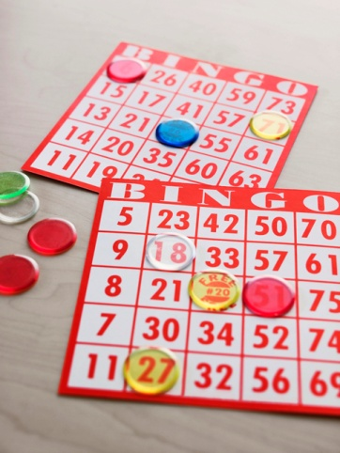
Welcome
READ 180 Mix and Mingle Bingo
Get up and move around the room!
Find a buddy who fits the description in a box.
Have your buddy initial the box.
Move on to another buddy . . .
Competitive? How many buddies can you get to initial your Bingo card in 15 minutes?

Slide 3
Objectives
Re-connect
Review
Reflect

Slide 4
Agenda
Morning
Afternoon
EPS READ 180 Overview
ITS, DTZ – huh?
First Three Weeks
Using Multiple Measures
Deep Dive into the rBook & Red Routines
Headphones & All Things Technical
Summarizing and the Explicit Teaching Model
READ 180 PLC
READ 180 Surveys
Evaluation

Slide 5
EPS READ 180 Overview

Slide 6
“Snapshot” of EPS READ 180
Nearly 900 students
  60% Male
  25% Hispanic
Students in grades 6 -12
  70% Middle School
  30% High School
Teachers at nine schools (34)
  8 Reading Support
  22 Special Education
  3 ELL

Slide 7
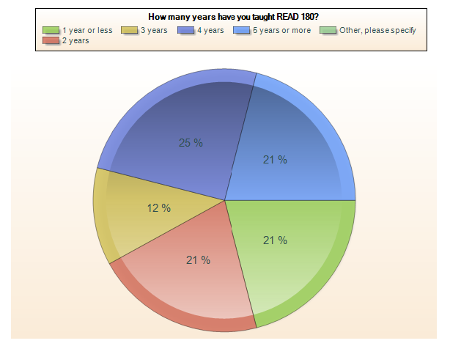
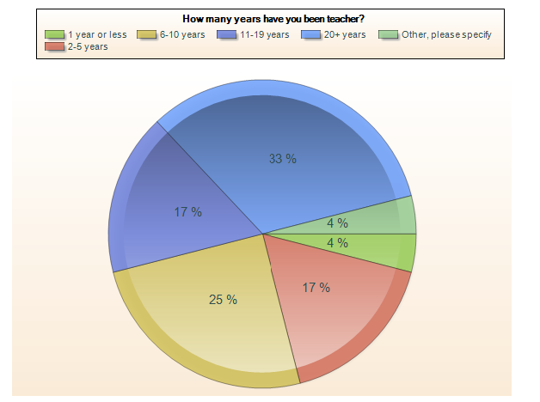
Survey Findings
Years Teaching READ 180
Years Teaching

Slide 8
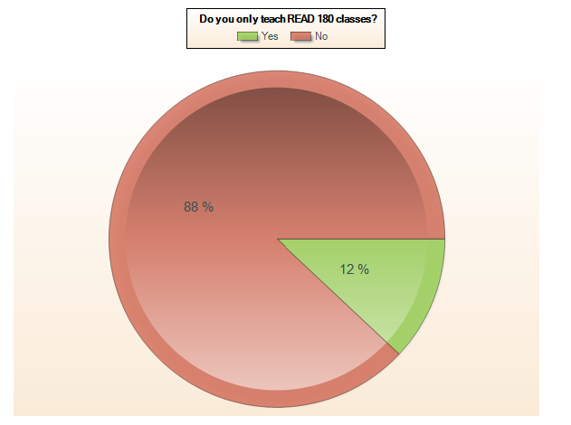
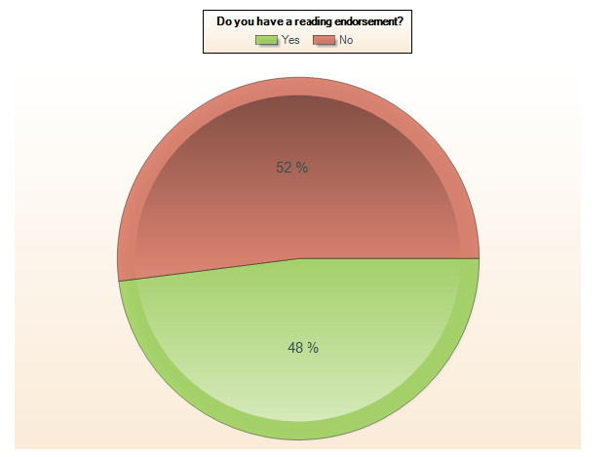
Survey Findings
Multiple Preps
Reading Endorsement

Slide 9


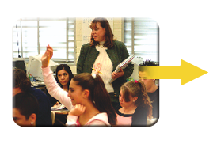



EPS READ 180 Rotation Model
20 minutes*
20 minutes*
Instructional
Software
Small-Group
Instruction
Whole-Group
Instruction
Whole-Group
Wrap-Up
20 minutes*
Modeled and
Independent
Reading
5 minutes*
5 minutes*
*Students complete two Small-Group rotations every day along with either Whole-Group Instruction or Whole-Group Wrap-Up.
20 minutes*
Notes:
The model as developed by Scholastic includes 5 rotations within a single class period. Two of the rotations are Whole Group and three are Small Group. Because we are implementing the model in 46 – 50 minute class periods, teachers are expected to have students complete two small group rotations and at least one modified whole group rotation.

Slide 10
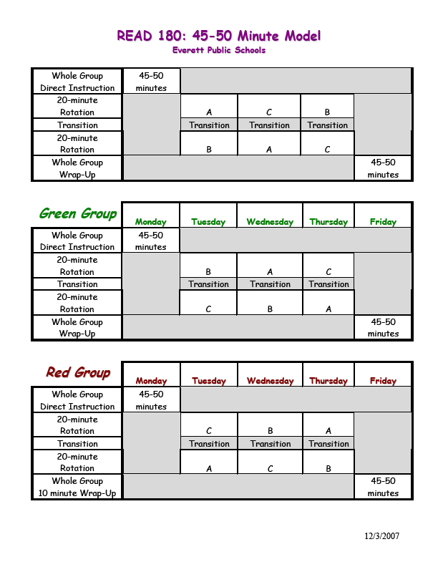
EPS Rotational Model
Blue Group
A=Independent Reading
B=Small Group
C=Instructional Software

Slide 11

rBook Scope and Sequence
Middle School Stage B & Flex rBooks
6th Grade | Stage B rBook Workshops 1-4
7th Grade | Stage B rBook Workshops 5-9
8th Grade | rBook Flex Workshops 1-4
As needed | rBook Flex Workshops 5-9
High School Stage C & Flex II rBooks
First Year Students | Stage C rBook Workshops 1-4
Second Year Students | Stage C rBook Workshops 5-9
Third Year Students | rBook Flex II Workshops 1-4
As needed | rBook Flex II Workshops 5-9

Slide 12

SRI Assessment Windows
Last SRI assessment window is May 31st – June 10th
Four SRI assessment windows per year:
  Beginning of school year (end of September)
  November
  March
  June

Slide 13
READ 180 Evidence of Impact
(Students with Baseline & EOY SRI/Lexile Scores 2007-08)
Scholastic Reading Inventory (SRI) Baseline and End-of-Year Data | Middle Schools (5 Schools) |  | High Schools (4 Schools)
 | Baseline | End of Year | Baseline | End of Year
READ 180 Average Gap between Reading Level and Grade Level | -4.3 | -3.4 | -6.7 | -5.7
READ 180 Median Gap between Reading Level and Grade Level | -5 | -4 | -7 | -6
READ 180 Average Lexile Score | 461.8 | 574.8 | 464 | 569.6
READ 180 Median Lexile Score | 483 | 632.5 | 502 | 610.5

Slide 14
READ 180 Software Usage
and SRI Comparisons
(Students with Baseline & EOY SRI/Lexile Scores 2007-08)
READ 180 Segments Completed | 0-10 (n = 287) | 11- 20 (n = 112) | 21- 30 (n = 30) | 31- 40 (n = 11) | 41- 50 (n = 4)
Average Lexile Growth | 101.2 | 138.7 | 106.5 | 38.7 | 111.2
Average Growth in Reading Levels (Based on Lexile Scores) | 0.9 | 0.9 | 0.53 | 0.27 | 0.9
READ 180 Total Minutes | 0- 500 (n = 192) | 501-1000 (n = 159) | 1001- 1500 (n = 61) | 1501- 2000 (n = 20) | 2001- 3000 (n = 5) | 3000+ (n = 1)
Average Lexile Growth | 101 | 125.4 | 131 | 59.9 | -11 | -150
Average Growth in Reading Levels (Based on Lexile Scores) | 0.8 | 1 | 0.92 | 0.38 | 0 | -1

Slide 15
Demographic Comparisons
(Students with Baseline & EOY SRI/Lexile Scores 2007-08)
Gender | Males (n=262) | Females (n=182)
Average Lexile Growth | 112.8 | 108.9
Average Growth in Reading Levels (Based on Lexile Scores) | 0.9 | 0.9
Meal Status | Yes (n=291) | No (n=153)
Average Lexile Growth | 95 | 142
Average Growth in Reading Levels (Based on Lexile Scores) | 0.75 | 1.2
Ethnicity | Asian (n=53) | Black (n=38) | Hispanic (n=96) | White (n=233) | Other (n=22)
Average Lexile Growth | 99.5 | 61 | 87.9 | 123.9 | 189.3
Average Growth in Reading Levels (Based on Lexile Scores) | 0.71 | 0.47 | 0.67 | 1 | 1.4

Slide 16
Years of Teaching Compared
to SRI Growth
(Students with Baseline & EOY SRI/Lexile Scores 2007-08)
Number of Years Teaching | 1 Year Or Less (n=90) | 2- 5 Years (n=46) | 6-10 Years (n=59) | 11-20 Years (n=13 | 20+ Years (n=59)
Average Lexile Growth | 54.7 | 120.1 | 108 | 139.9 | 94.6
Average Growth in Reading Levels (Based on Lexile Scores) | 0.6 | 0.9 | 0.7 | 1.2 | 0.7
Number of Years Teaching READ 180 | 1 Year or Less (n=370) | 2 Years (n=37) | 3+ Years (n=37)
Average Lexile Growth | 107.8 | 134.5 | 121.8
Average Growth in Reading Levels (Based on Lexile Scores) | 0.9 | 1 | 1

Slide 17
ITS, DTZ – huh?

Slide 18
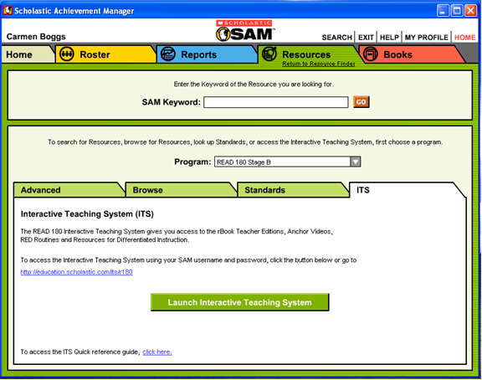
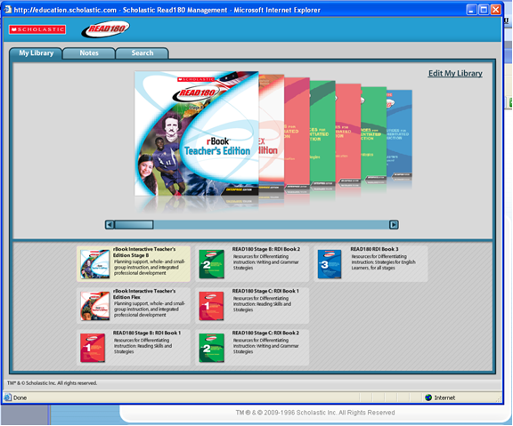
Interactive Teaching System (ITS)
http://education.scholastic.com/its/r180
The READ 180 Teacher Shared Space is a great resource too!

Slide 19

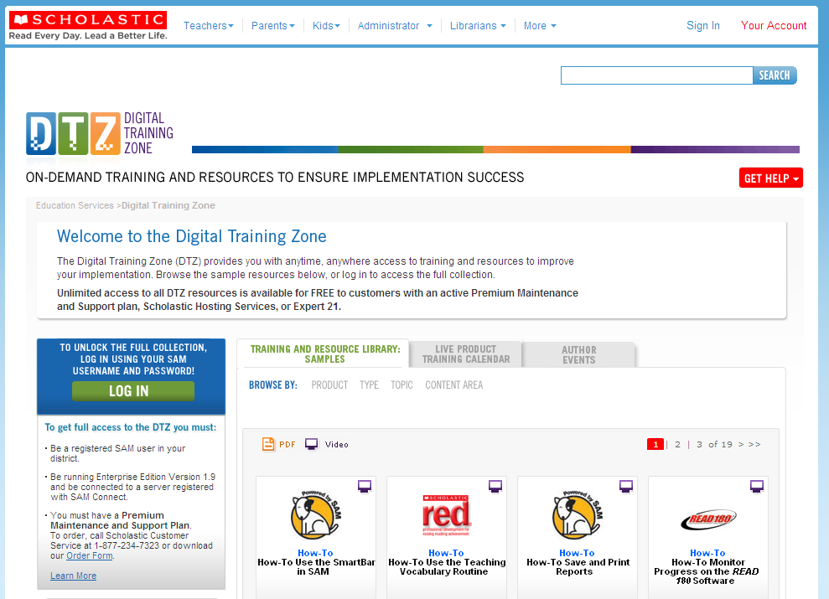
Digital Training Zone (DTZ)
http://teacher.scholastic.com/products/edservicesondemand/digitaltrainingzone.asp

Slide 20
First Three Weeks

Slide 21

First Three Weeks
Why wait to start?
Why start with the First Three Weeks?
Supplementing the First Three Weeks
  Deeper Look at Writing
  “I supplement the First Three Weeks by ____________________________”

Slide 22
Last Three Weeks
Possibilities . . . ?

Slide 23
Using Multiple Measures

Slide 24
Using Multiple Measures
Entrance and Exit Criteria
Lexile scores
SAM Reports
Grading Practices

Slide 25
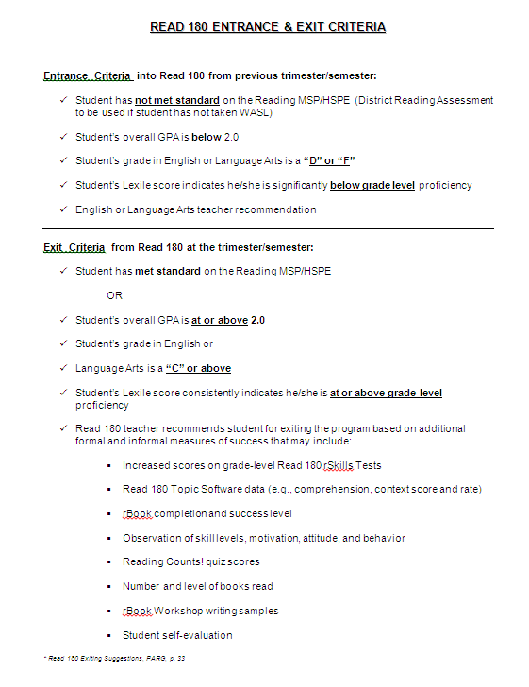
Entrance & Exit Criteria

Slide 26
Lexile Scores & Grade Levels
Grade | At Risk | Basic | Proficient | Advanced
1 | N/A | BR=99- | 100-400 | 401+
2 | 99- | 100-299 | 300-600 | 601+
3 | 249- | 250-499 | 500-800 | 801+
4 | 349- | 350-599 | 600-900 | 901+
5 | 449- | 450-699 | 700-1000 | 1001+
6 | 499- | 500-849 | 800-1050 | 1051+
7 | 549- | 550-849 | 850-1100 | 1101+
8 | 599- | 600-899 | 900-1150 | 1151+
9 | 649- | 650-999 | 1000-1200 | 1201+
10 | 699- | 750-1024 | 1025-1250 | 1251+
11 | 799- | 800-1049 | 1050-1300 | 1301+

Slide 27
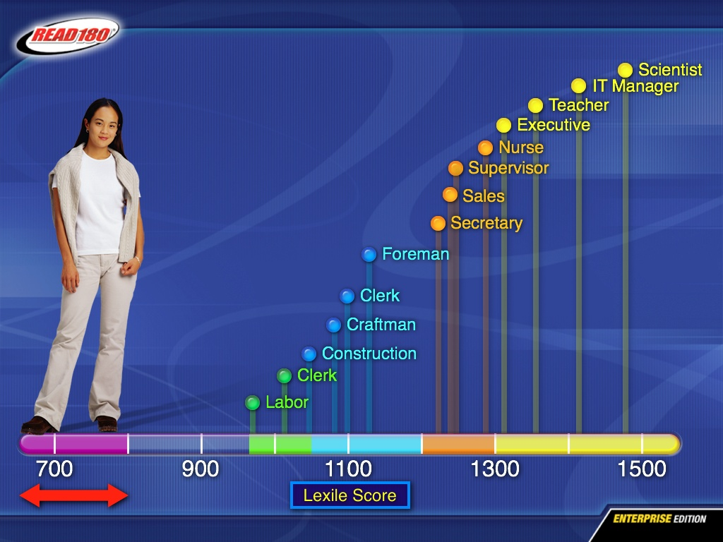
On-the Job Lexile Requirements
National Adult Literacy Study
Joyce and Showers (1996)
Student Achievement
Through Staff Development
Notes:
27
Let’s take a look at the Lexile demands of the workplace compiled by the National Adult Literacy Study.
You’d expect to see the highest Lexile demands for professionals such as teachers, scientists and executives.
Today, even relatively unskilled jobs start at a 1000 Lexile. Why? Because almost every worker today is likely to encounter technology. That means technical reading and manuals. As one thought leader has asked, “Would you want your breaks installed by someone who hadn’t read the manual?”
[click]
Yet, many of our struggling readers leave high school reading at 900 Lexile. What are the prospects for them?

Slide 28
SAM Reports
READ 180 Reading Progress Report
  Are there usage patterns and correlations between time and performance data?
Reading Counts Reading Progress Report
  Are there incentives or ways to help students monitor their progress based on this report? Is there a need for reading groups based on this report?
SRI Growth Report
  Are students making significant growth in the program? What interventions or support are needed for students? What incentives and motivation is needed?
Take a look at your reports.
Work with your group to unpack these questions.
What questions do you have?
If time allows:
In your group, share out your grading practices . . .

Slide 29
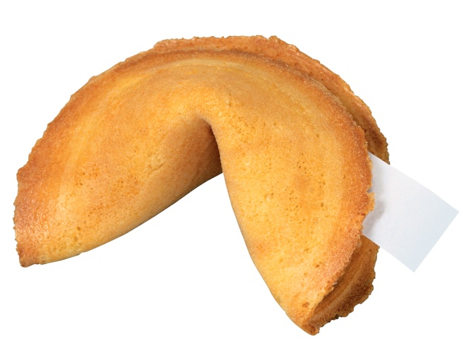
Fortune Cookie Share-out
Open your fortune cookie; open it but don’t read the “fortune” out loud or share it with anyone else.
Think how this “fortune” may relate to you, your READ 180 work and the data we just looked at. Jot down notes if you wish as you will be asked to share this.
“Go round” one at a time and read your “fortunes.” Describe how it relates to your READ 180 work. What are your next steps after looking at the data?
Eat the fortune cookie!
Adapted from www.nsrfharmony.org,
Dave Lehman, April 28, 2005

Slide 30
Deep Dive into the rBook & Red Routines

Slide 31
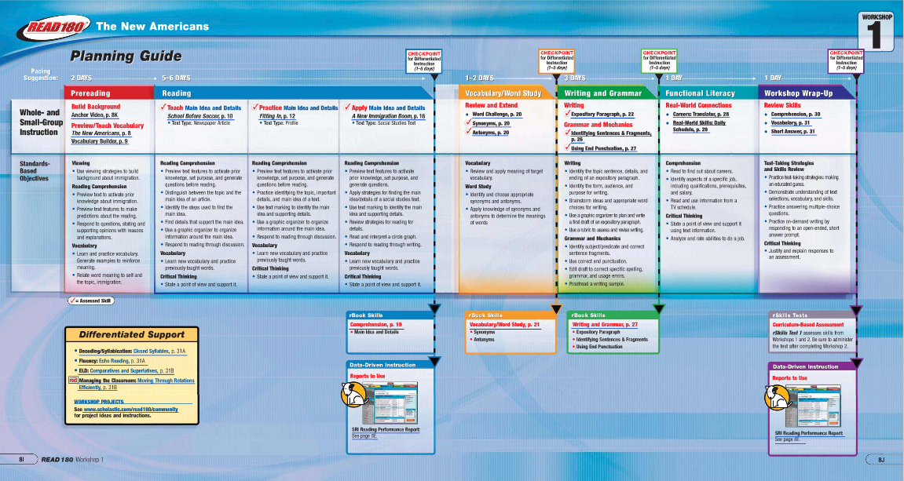
rBook: Workbook + Planner

Slide 32
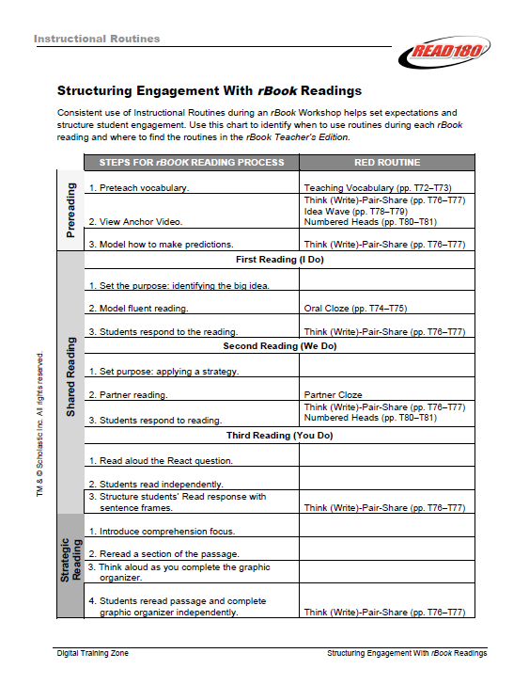
Explicit Instructional Model
& the Red Routines
Five Red Routines for reading
  Teaching Vocabulary
  Oral Cloze
  T-W-P-S
  Idea Wave
  Numbered Heads
Two Red Routines for writing
  The Writing Process
  Peer Feedback
Three rBook readings
  I do
  We do
  You do

Slide 33
Why Nonfiction?
Numbered Heads
  Count off 1, 2, 3, 4
Go to your new group:
    A Literacy Necessity, A Place for Nonfiction
    Reading Interests, How Many Books?, How Can Teachers Obtain Books For Classroom Library Collections?
    What Kinds of Information Books Should I Include?
    Effective Library Areas, The Role of Teacher, Conclusion
Read/skim the sections from the reading assigned to your group.
Discuss with your group:
What ideas stood out from the section(s) you read?
What impact does this have on my students?

Slide 34
Headphones & All Things Technical
with the wonderful Terie Messick

Slide 35
Headphones & All Things Technical
Headphone troubleshooting
Purchasing headphones
Other computer issues
Adding and deleting students
Software problems
“The Help Desk and/or the Techs helped me with READ 180 when _____________________________”

Slide 36

What is FASTT Math?

Slide 37
Summarizing & the Explicit Teaching Model
with the fabulous Cindy Foster

Slide 38
READ 180 PLCs
with the lovely Carmen Boggs

Slide 39
READ 180 Surveys

Slide 40
READ 180 Teacher Survey Highlights – What Do You Value Most About READ180?
Everything - I believe this program works and creates independent readers.
I like that the program is easy to use (well planned and easy to follow) and that my students seem to like the topics that are presented.
How structured the program is, and the ease of implementation.
I value the balance between pleasure reading and academic reading.
It has helped my students feel successful.
The rbooks and teacher book.
Instructional strategies
All of it! I only wish it was all I taught and that I coaudl do the 90 minute model. I LOVE READ 180!
Small group interaction with students
I especially value the softcover books.
The gains my students are making in reading
Richness of materials, flexibility.
Great program and it really helps students to learn to read.
Read 180 Software
The focused instruction
The computer program
Time in small group to work with students and give immediate feedback.
I value the individualize instruction.
It is a diverse program, offering multiple strategies and materials.
the ability to see the individual student's needs
The balanced approach with reading and writing as well as other skills connected in the language arts program.
The consistency and multi-targeted approach in the rBook
I like the idea of helping struggling readers.
The is a great variety of reading materials for students to choose from.

Slide 41
READ 180 Teacher Survey Highlights – What Motivates Students?
They work at their own level of excellence.
An increase in their Lexile scores is one form of motivation for my students. Also, they feel successful because they receive immediate feedback from the computer program.
The different types of books available at their reading level.
Feeling successful in school.
The bond we have as a class, the computer program and the books to read.
Reading books that are interesting, and writing on the Moodle.
Frequent experiences of success
Success...reading a book they CAN read, at passing the quizzes and the looks on their faces when they see how much they have gone up on their Lexile score...PRICELESS!!!!
Audiobooks and computers
The students feel that the program is teaching them in a cool way.
The interesting content of materials, frequent feedback about progress
Teacher enthusiasm and knowledge of materials; goal setting and personal attention; Immediate feedback.
Positive feedback
Books that interest them
Seeing their own achievement
Completing a section
Immediate feedback, goal setting, and encouragement from educators.
Improving their SRI score motivates my students.
The anchor videos and whole group discussions seem the most motivational aspects.
The climate that I've built in class...this is not a "dumb" reading class
Being able to improve reading scores and exiting from the program after enough growth on classroom, district and state assessment improvements are shown.
They find the topics and activities in the R book very interesting and LOVE the positive feedback they receive when using the computer.
No idea. My students are rarely motivated.
Success seems to be a wonderful motivator. When students see themselves making progress on their SRI scores, their reading counts quizzes or software activities, they are inspired to continue working and trying harder.

Slide 42
READ 180 Student Survey
Think
  Skim the Student Information Surveys
  What question(s) do you have for READ 180 students?
Write
  On an index card, write a question you would like to ask READ 180 students.
Pair
  Share and discuss the questions you wrote on the index card.
Share
  Using the sentence starter, share a question you would like to ask READ 180 students with the group:
  One question I have for my READ 180 students is “______________________________________?”

Slide 43
Tell the story of a READ 180 Student . . .
Skim through our list of what motivates READ 180 students. (Writing Process: Generate Ideas)
Choose an idea or two from the list and imagine a student or group of students this idea describes. (Writing Process: Plan)
Tell the story of this student and describe how this student is or has become motivated . . . (Writing Process: Write)
We’ll skip over Revision and Editing.
Share your story with a partner. (Writing Process: Final Draft/Present)

Slide 44
READ 180 Contest
Statements describing how READ 180 has helped to make a difference in your school or classroom.
Prizes are books.
Information available on READ 180 website.

Slide 45
Evaluations
Thank you for a wonderful day together!

Slide 46


“I Used to Think . . .
And Now I Think . . .”
I Used to Think . . .
And Now I Think . . .
Adapted from “I Used to Think…and Now I Think…” by Richard F. Elmore

